Slide 1
Machine Learning AIML CZG565
M1 : Introduction
Prof Neha Vinayak
neha.vinayak@pilani.bits-pilani.ac.in

Slide 2

Machine Learning
Disclaimer and Acknowledgement
The content for these slides has been obtained from books and various other source on the Internet
I hereby acknowledge all the contributors for their material and inputs.
I have provided source information wherever necessary
I have added and modified the content flow to suit the requirements of the course and for ease of class presentation
Students are requested to refer to the textbook and detailed content of this presentation deck over canvas

Slide 3
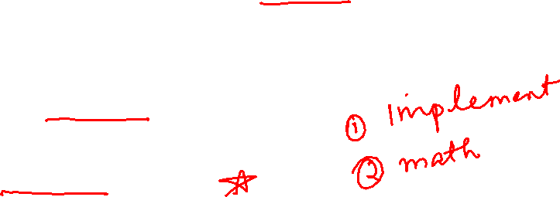
Course Introduction
Objective of course
Introduction to the basic concepts and techniques of Machine Learning
Gain experience in basics of doing independent study and research in the field of Machine Learning
Develop skills of using recent machine learning software tools to evaluate learning algorithms and model selection for solving practical problems
Focus of this course
Strong Mathematical Foundations of ML algorithms
Structured Data Analytics
IDD (Independent & Identically Distributed Data)
Topics not expected of this course
Unstructured Data Analytics
Time Series/Sequence Data Analytics
Deep Learning
22 November 2023

Slide 4
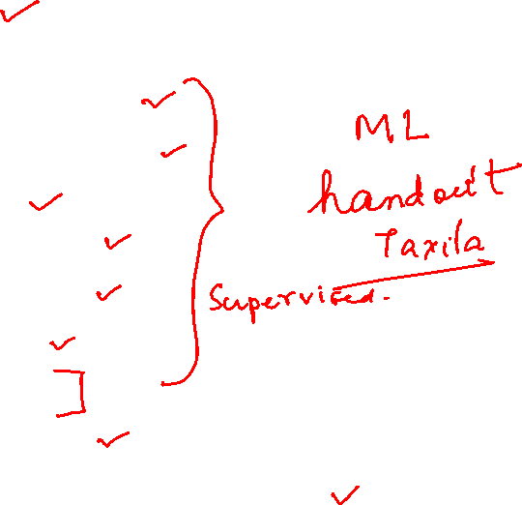
Course Plan
M1 | Introduction
M2 | Machine learning Workflow
M3 | Linear Models for Regression
M4 | Linear Models for Classification
M5 | Decision Tree
M6 | Instance Based Learning
M7 | Support Vector Machine
M8 | Bayesian Learning
M9 | Ensemble Learning
M10 | Unsupervised Learning
M11 | Machine Learning Model Evaluation/Comparison

Slide 5
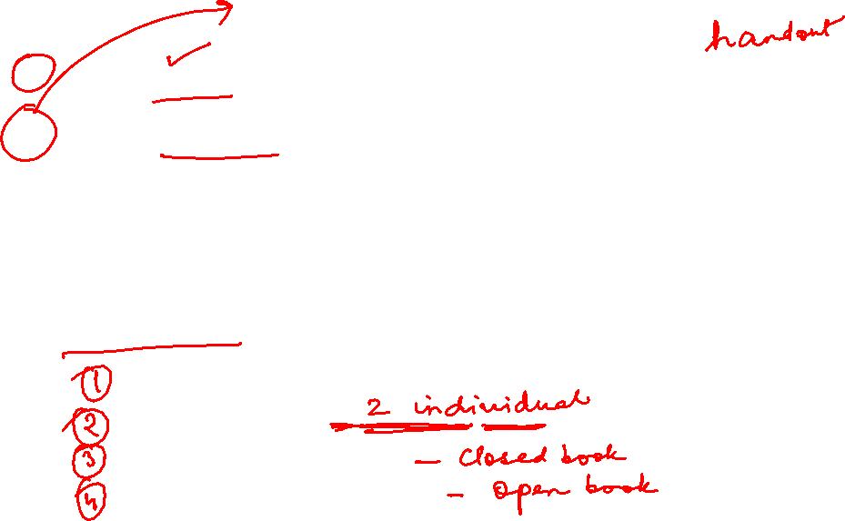
Text books and Reference book(s)
T1 | Tom M. Mitchell: Machine Learning, The McGraw-Hill Companies
R1 R2 R3 | Christopher M. Bishop: Pattern Recognition & Machine Learning, Springer P. Tan, et al. Introduction to Data Mining, Pearson C.J.C. BURGES: A Tutorial on Support Vector Machines for Pattern Recognition, Kluwer Academic Publishers, Boston. Evaluation scheme Quiz (10% - Best 2 of 3 quizzes) Assignment (20% - 1 Progressive Group Assignment) Mid-semester exam (30%) Comprehensive exam (40%)

Slide 6

Pre-requisites
Linear algebra: vector/matrix manipulations, properties
Calculus: partial derivatives
Probability: common distributions; Bayes Rule
Statistics: mean/median/mode; maximum likelihood

Slide 7

Lab Plan
Lab No. | Lab Objective
1 | End to End Machine Learning
2 | Linear Regression and Gradient Descent Algorithm
3 | Logistic Regression Classifier
4 | Decision Tree
5 | Naïve Bayes Classifier
6 | Random Forest
Labs not graded
Most of the Lab recordings available at CSIS virtual labs
Webinars will be conducted for lab sessions
Labs will be conducted in Python

Slide 8
Agenda
What is Machine Learning?
Why Machine Learning is important?
Types of Machine Learning
Application Areas
Issues in Machine Learning
Demo Case study
Notes:
Machine Learning, Tom Mitchell
Read Chapter 1, 2 – Introduction to Machine Learning, 2nd edition, Ethem Alpaydin

Slide 9
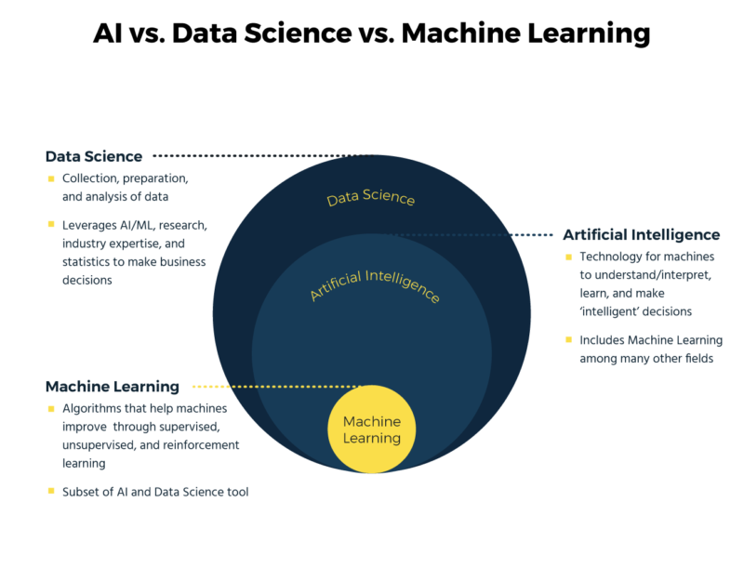


Slide 10

AI vs DS vs ML
AI
Collection, preparation and analysis of data
DATA SCIENCE
MACHINE LEARNING

Slide 11
Common Use Cases
Applications in Smartphones
Transportation Optimization
Popular Web Services
Sales and Marketing
Security
Financial Domain

Slide 12
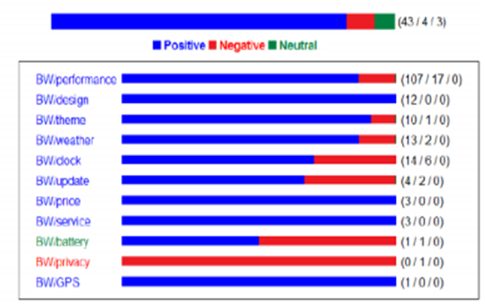
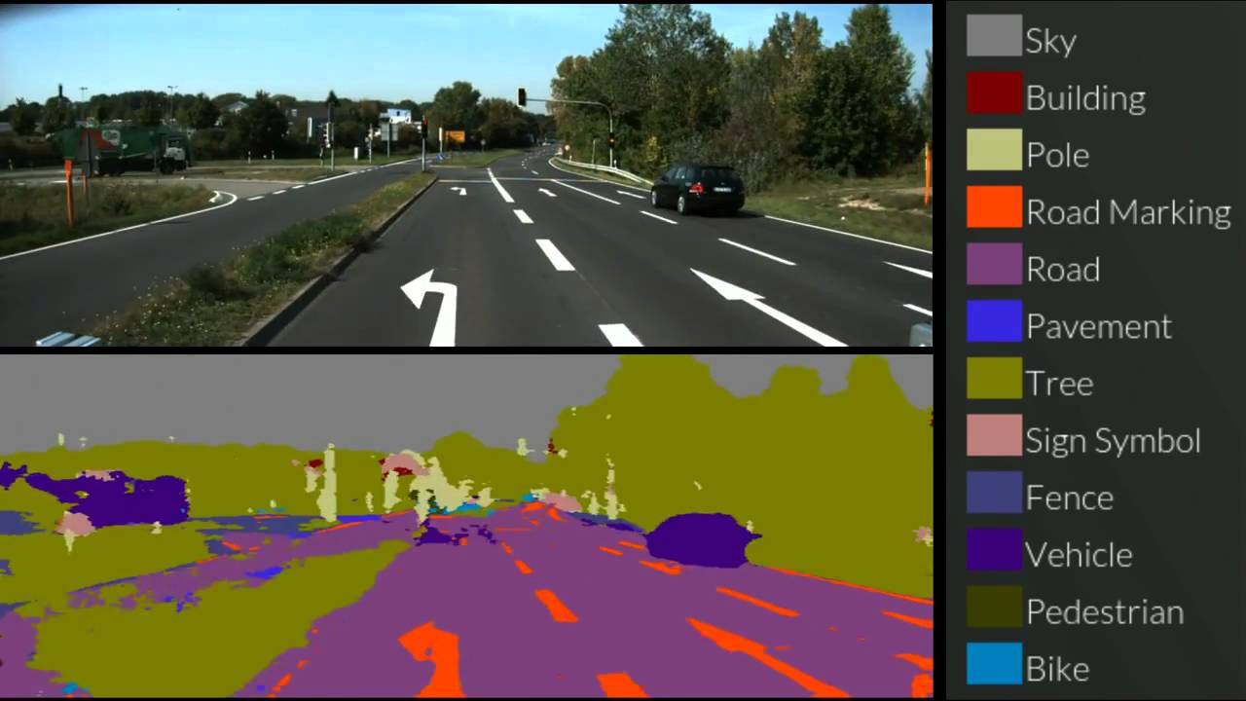
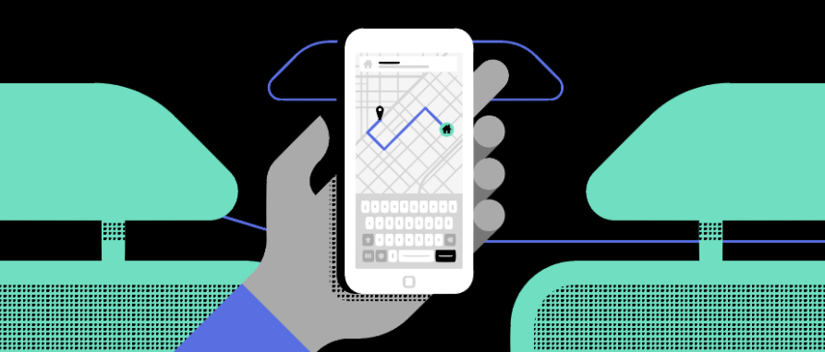

Introduction to Machine Learning
Common Use cases - Security & Transaction Domain
Self-Driving Cars
Fraud Detection in Banking
Email Filtering
Dynamic Pricing in Travel
Derived Applications:
> Cyber Security
> Video Surveillance
> Object Detection
Sentiment analysis on Product review of Mobile phone

Slide 13

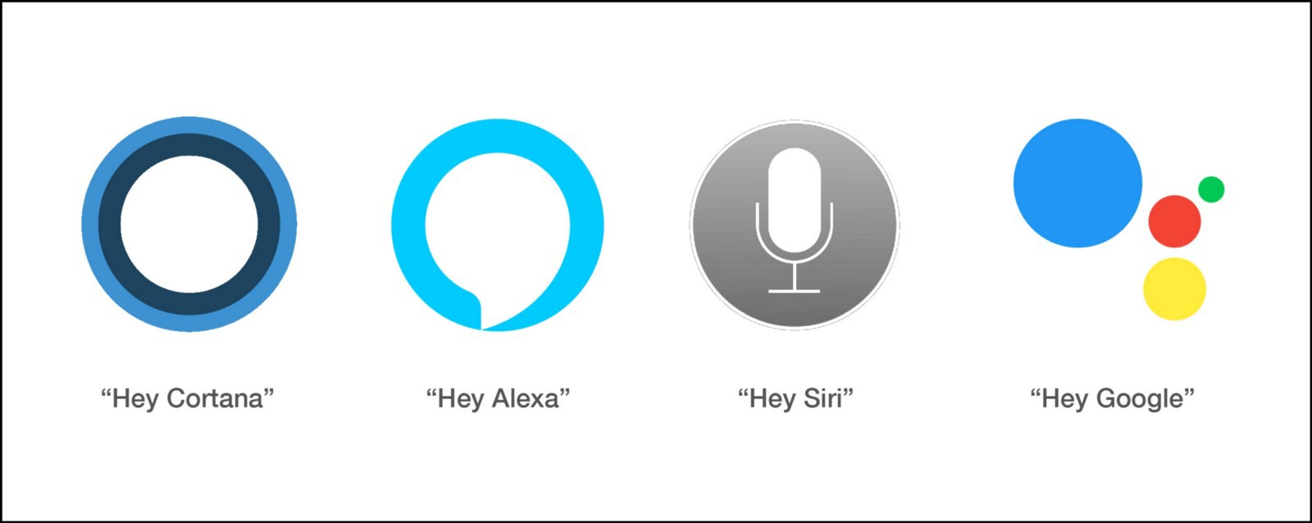
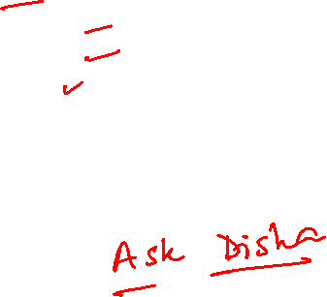
Introduction to Machine Learning
Common Use cases - Customer Support Systems
Apple’s Siri
Google Assistant
Amazon’s Alexa
Google Duplex
Microsoft’s Cortana
Samsung’s Bixby
Derived Applications:
> Customer Support Query (Voice vs Text)
> Chatbots

Slide 14

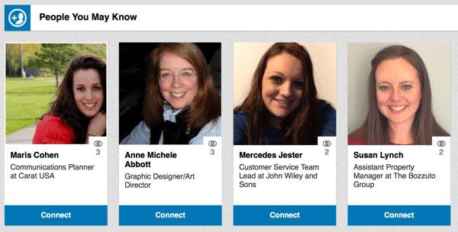


Introduction to Machine Learning
Common Use cases - Recommendation Engines
E-commerce sites like Amazon and Flipkart
Book sites like Goodreads
Movie services like IMDb and Netflix
Hospitality sites like MakeMyTrip, Booking.com, etc.
Retail services like StitchFix
Food aggregators like Zomato and Uber Eats
Derived Applications:
> Personalized Marketing
> Personalized Banking

Slide 15

ML – What, When, Where ?

Slide 16
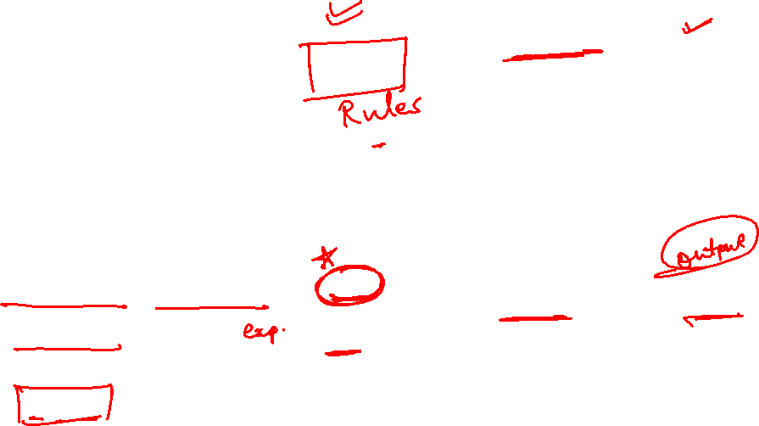
Introduction to Machine Learning
What is Machine Learning (ML)?
The science (and art) of programming computers so they can learn from data
More general definition
Field of study that gives computers the ability to learn without being explicitly programmed
Engineering-oriented definition
Algorithms that improve their performance P at some task T with experience E
A well-defined learning task is given by <P, T, E>
Traditional programming
Computer
Data
Program
Output
Machine Learning
Computer
Data
Output
Program
Slide credit: Pedro Domingos

Slide 17
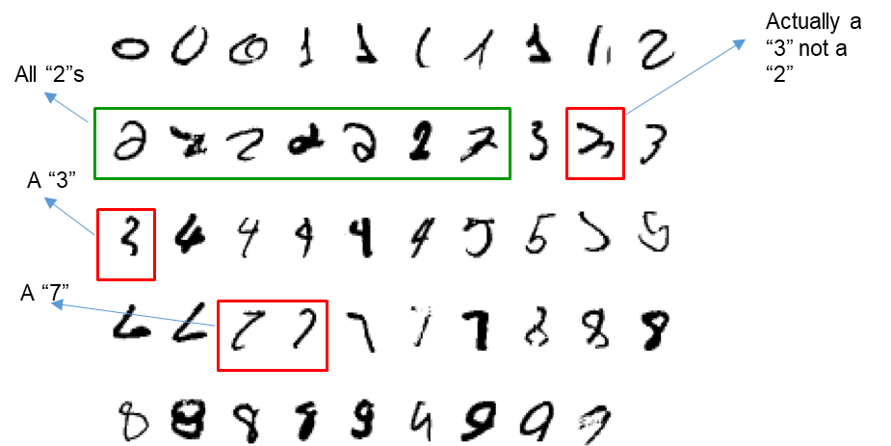

Introduction to Machine Learning
Defining the Learning Tasks
Improve on task T, with respect to performance metric P, based on experience E
Example 1
T: Recognizing hand-written words
P: Percentage of words correctly classified
E: Database of human labelled images of handwritten words
Example 2
T: Categorize email messages as spam or legitimate.
P: Percentage of email messages correctly classified.
E: Database of emails, some with human-given labels

Slide 18
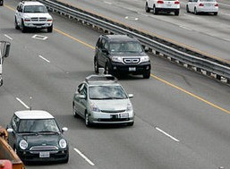
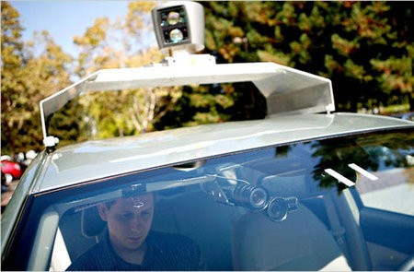

Introduction to Machine Learning
Defining the Learning Tasks
Improve on task T, with respect to performance metric P, based on experience E
Example 3
T: Playing Checkers
P: Percent of games won against opponents
E: Games Played against itself
Example 4
T: Drive on public four-lane highways using vision sensors.
P: Average distance travelled before an error (as judged by human).
E: A sequence of images and steering commands recorded while observing a human driver

Slide 19
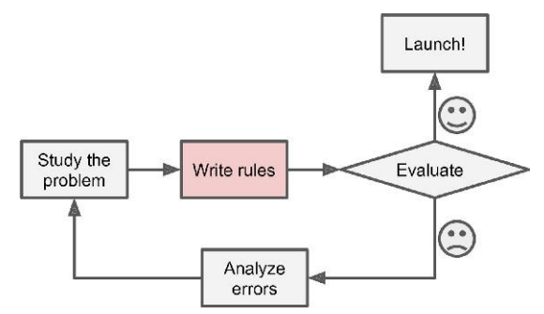

Introduction to Machine Learning
Traditional Approach - Spam Filtering
Spam typically uses words or phrases such as “4U,” “credit card,” “free,” and “amazing”
Solution
Write a detection algorithm for frequently appearing patterns in spams
Test and update the detection rules until it is good enough.
Challenge
Detection algorithm likely
to be a long list of complex rules
hard to maintain.

Slide 20
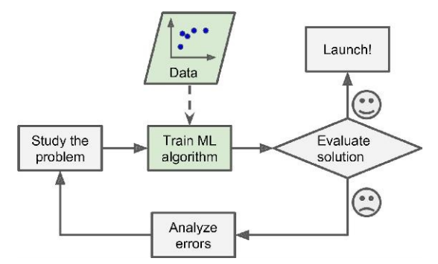

Introduction to Machine Learning
ML Approach - Spam Filtering
Automatically learns phrases that are good predictors of spam by detecting unusually frequent patterns of words in spams compared to “ham”s
The program is much shorter, easier to maintain, and most likely more accurate.

Slide 21
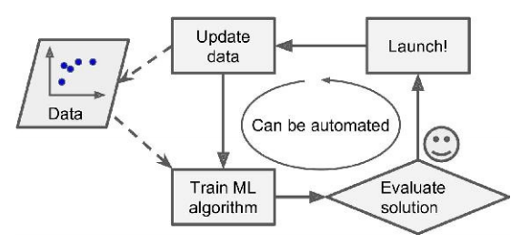
Introduction to Machine Learning
ML Approach - Spam Filtering
Automatically learns phrases that are good predictors of spam by detecting unusually frequent patterns of words in spams compared to “ham”s
The program is much shorter, easier to maintain, and most likely more accurate.

Slide 22
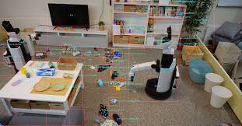


Introduction to Machine Learning
Applications - Perspectives
Object Categorization Sequence Prediction
Forecasting
Medical Research
Recommendation System
Content Management
Medical Diagnosis
Transaction Analysis
Recommendation System
Speech – Text Processing

Slide 23
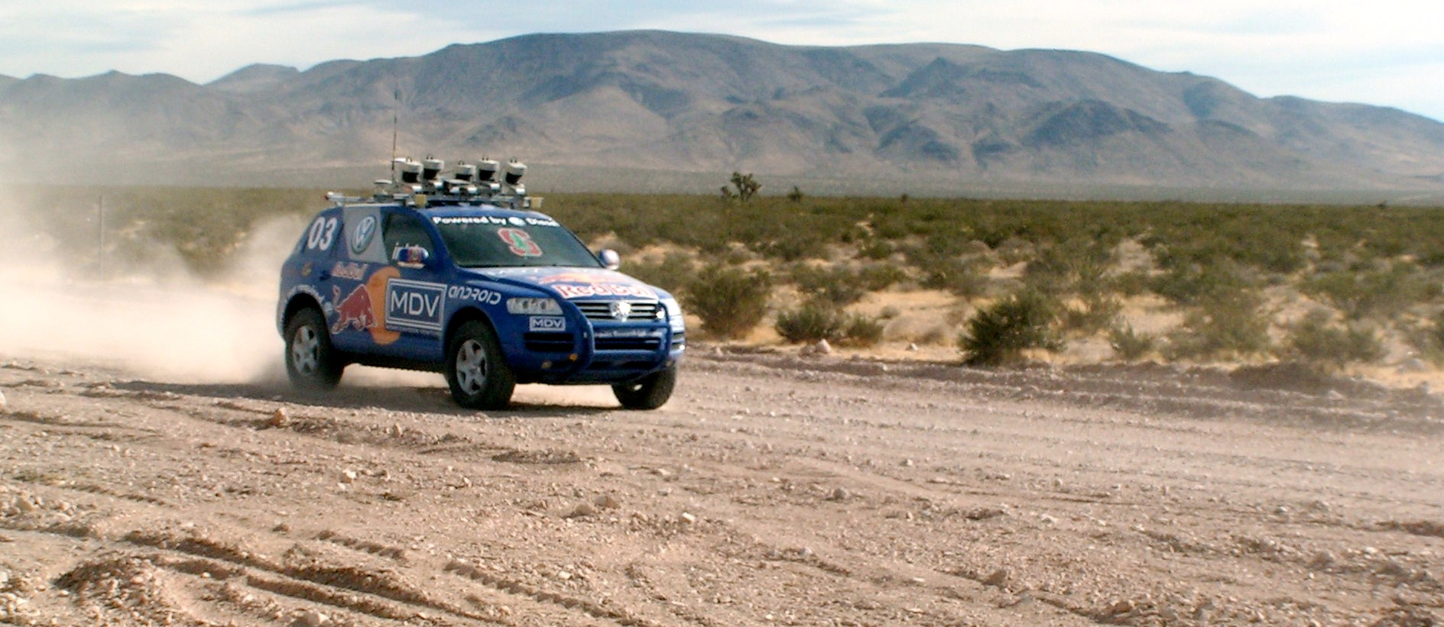

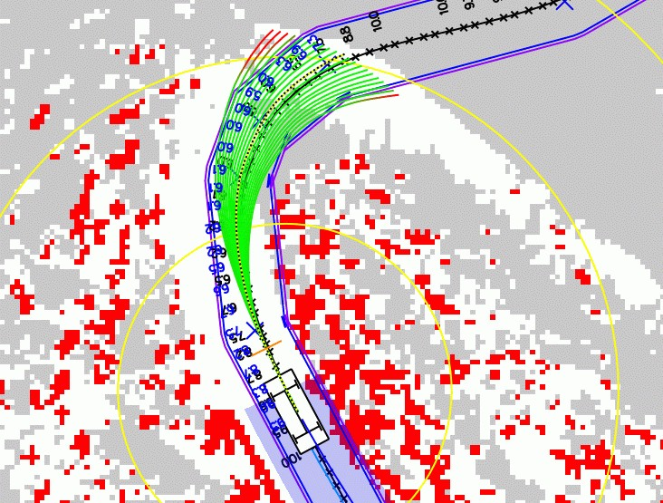
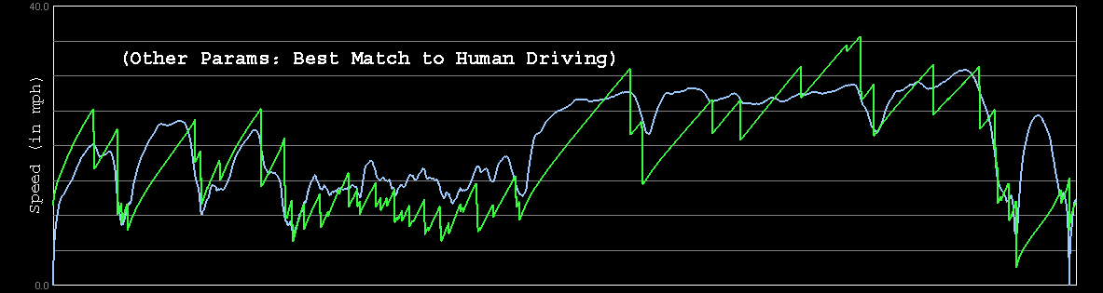

Introduction to Machine Learning
Applications - Perspectives
Planning Problem Solving
Navigation
Path Finding
Gaming
Controlling
Pattern Recognition
Optimization
Decision System
Laser Terrain Mapping
Learning from Human Drivers
Steve
Adaptive Vision
Stanley

Slide 24
Why ML

Slide 25
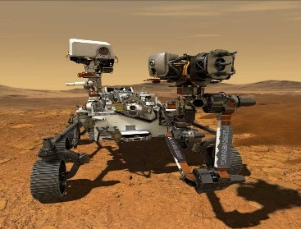

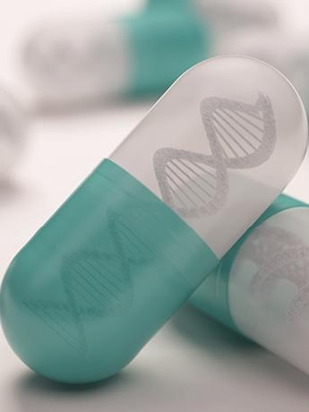


When Do We Use Machine Learning?
ML is used when:
Human expertise does not exist (navigating on Mars)
Humans can’t explain their expertise (Biometrics)
Models must be customized (personalized medicine)
Learning isn’t always useful:
There is no need to “learn” to calculate payroll

Slide 26
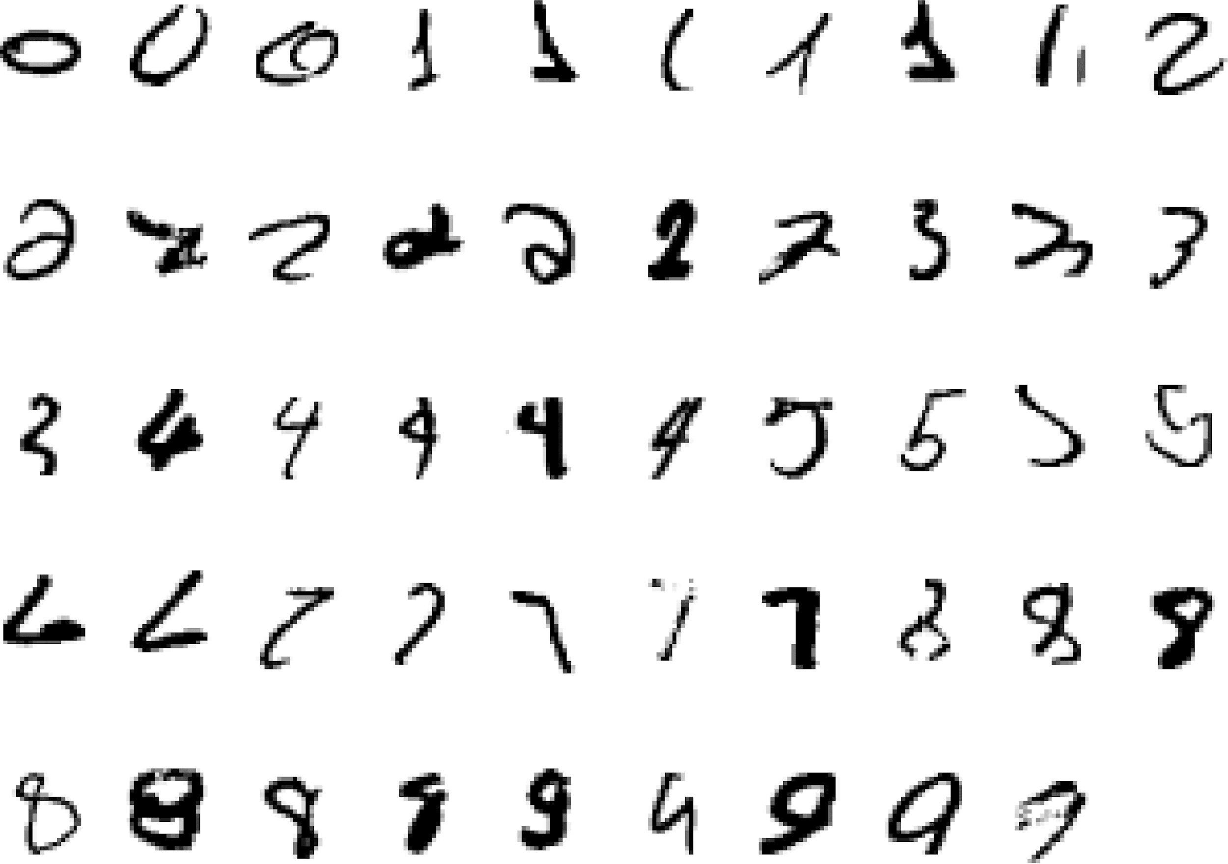
It is very hard to say what makes a 2
Pattern recognition
Slide credit: Geoffrey Hinton

Slide 27
Types of ML

Slide 28
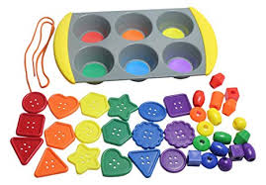
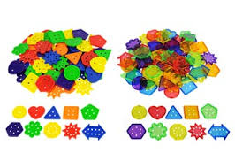
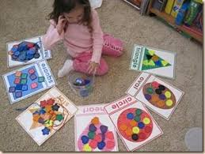
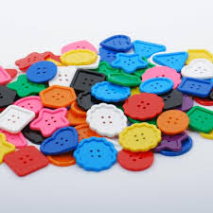
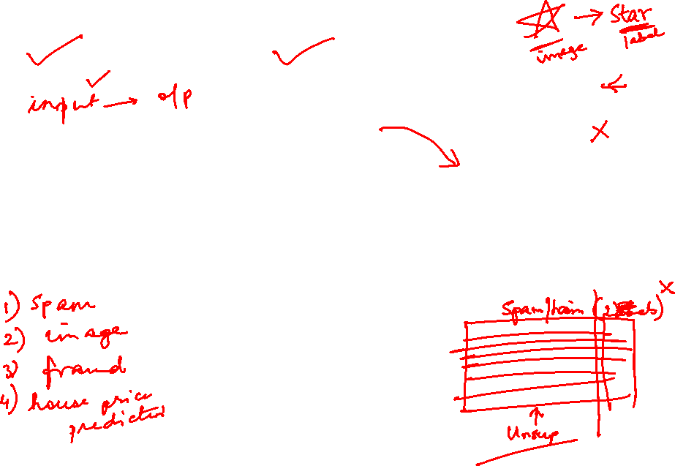
Introduction to Machine Learning
Types : Inputs: Based on level of supervision
Feedback | No Feedback | Delayed Feedback (rewards/penalty)
Supervised | Unsupervised | Reinforcement

Slide 29
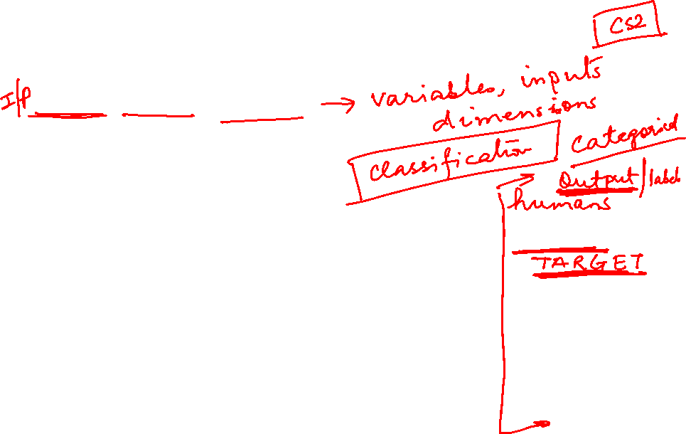
Machine Learning - Examples
Objective: Employability Prediction
Features / Attributes / Predictors
CGPA
Communication Skills
Aptitude
Programming Skills
S.No. | CGPA | Communication Skills | Aptitude | Programming Skills | Job Offered?
1 | 9.1 | Average | Good | Excellent | Yes
2 | 8.4 | Good | Good | Good | Yes
3 | 8.3 | Poor | Average | Average | No
4 | 7.1 | Average | Good | Average | No
5 | 8.2 | Good | Excellent | Excellent | No

Slide 30
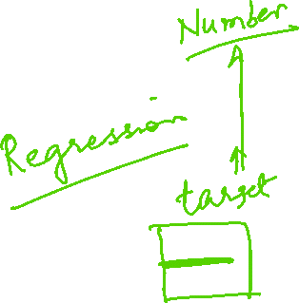
Machine Learning - Examples
Objective : Predicting price of a used car
Features / Attributes / Predictors
Brand
Year (Mfg)
Engine Capacity
Mileage
Distance travelled
Cab?
S.No | Brand | Year (Mfg) | Engine Capacity | Mileage | Distance travelled | Cab? | Price (in Rs.)
1. | Honda City ZX | 2008 | 1100 | 10.5 | 45000 | N | 3,50,000
2
3
4

Slide 31
Machine Learning - Examples
Objective: Market Segmentation Study
Features / Attributes / Predictors
Customers for a retailer may fall into
two groups say big spenders and
low spenders
three groups say big spenders,
medium spenders and low spenders
Four groups, ….
Family income
# of visits in a month
Average money spent in a month
Zip code
S.No. | Zip Code | Family Income | # of visits in a month | Average Money Spent in a month
1 | 500078 | 11,50,000 | 4 | 8,000

Slide 32










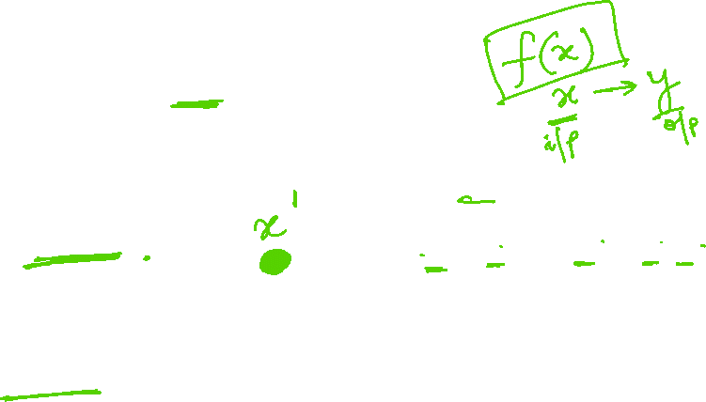
Introduction to Machine Learning
Supervised Learning: Classification
GOAL : Previously unseen records should be assigned a class as accurately as possible.
Given (x₁, y₁), (x₂, y₂), ..., (x_{n}, y_{n})
Learn a function f (x) to predict y given x
– y is categorical
Cancer (benign / malignant)
y=1 (malignant)
y=0 (benign)
Tumor Size (x)
Slide Credit: Eric Eaton

Slide 33








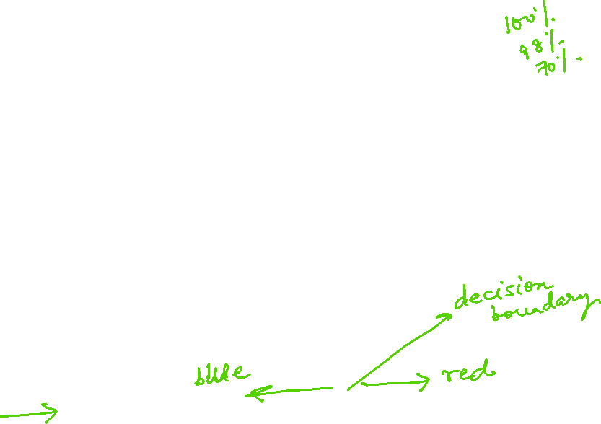
Introduction to Machine Learning
Supervised Learning: Classification
Learnt classifier
If x>T, malignant else benign
Given (x₁, y₁), (x₂, y₂), ..., (x_{n}, y_{n})
Learn a function f (x) to predict y given x
– y is categorical
Cancer (benign / malignant)
y=1 (malignant)
y=0 (benign)
Tumor Size (x)

Slide 34
Introduction to Machine Learning
Classification Applications
Google Image Classification
Face recognition system
Spam filters – Specific Controls
Document tagging
Fraud detection

Slide 35











Introduction to Machine Learning
Supervised Learning: Classification
x can be multi-dimensional
– Each dimension corresponds to an attribute
Increasing Feature Dimension
Clump Thickness
Uniformity of Cell Size
Uniformity of Cell Shape
…
Age
Tumor Size

Slide 36

Introduction to Machine Learning
Supervised Learning Techniques / Algorithms
Linear Regression
Logistic Regression
Naïve Bayes Classifiers
Support Vector Machines (SVMs)
Decision Trees and Random Forests
Neural networks

Slide 37

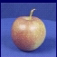
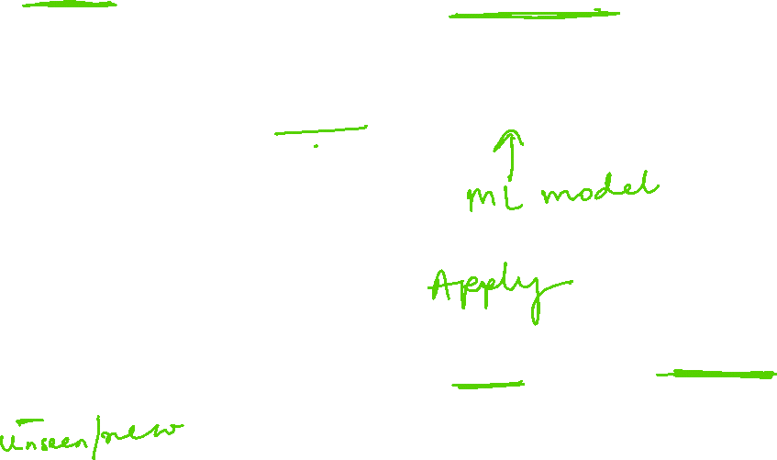
A Typical Supervised Learning Workflow (for Classification)
Training
Training Images
Training Labels
Features
Training
Learned model
Testing
Features
Learned model
Prediction
Test Image
Slide credit: D. Hoiem and L. Lazebnik

Slide 38




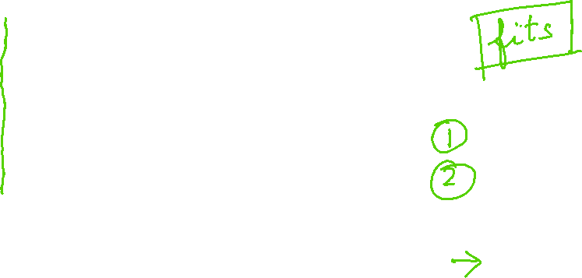
Introduction to Machine Learning
Supervised Learning: Regression
GOAL : Previously unseen records should be assigned a value as accurately as possible.
Given (x₁, y₁), (x₂, y₂), ..., (x_{n}, y_{n})
Learn a function f (x) to predict y given x
– y is real-valued
9
8
7
6
5
4
3
2
1
0
1970 1980
September Arctic Sea Ice Extent (1,000,000 sq km)
Year Number
1990
2000
2010
2020
Data from G. Witt. Journal of Statistics Education, Volume 21, Number 1 (2013) Slide Credit: Eric Eaton

Slide 39















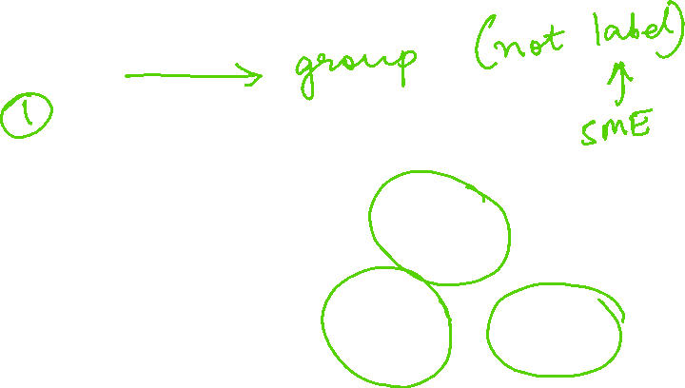
Introduction to Machine Learning
Unsupervised Learning
GOAL : Intra cluster distances are minimized and inter cluster distances are maximized
Given x₁, x₂, ..., x_{n} (without labels)
Output hidden structure behind the x’s
e.g., clustering
Slide Credit: Eric Eaton

Slide 40
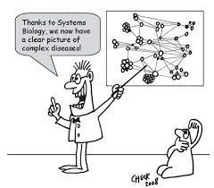
Introduction to Machine Learning
Unsupervised Learning Applications
Personalized recommendation system
Targeted marketing
Spam Filters
Content Management – News hosted in Web
Campaigning

Slide 41
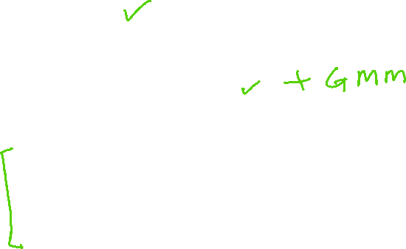
Introduction to Machine Learning
Unsupervised Learning Techniques
Clustering
k-Means
Hierarchical Cluster Analysis
Expectation Maximization
Visualization and dimensionality reduction
Principal Component Analysis (PCA)
Kernel PCA
Locally-Linear Embedding (LLE)
t-distributed Stochastic Neighbor Embedding (t-SNE)

Slide 42
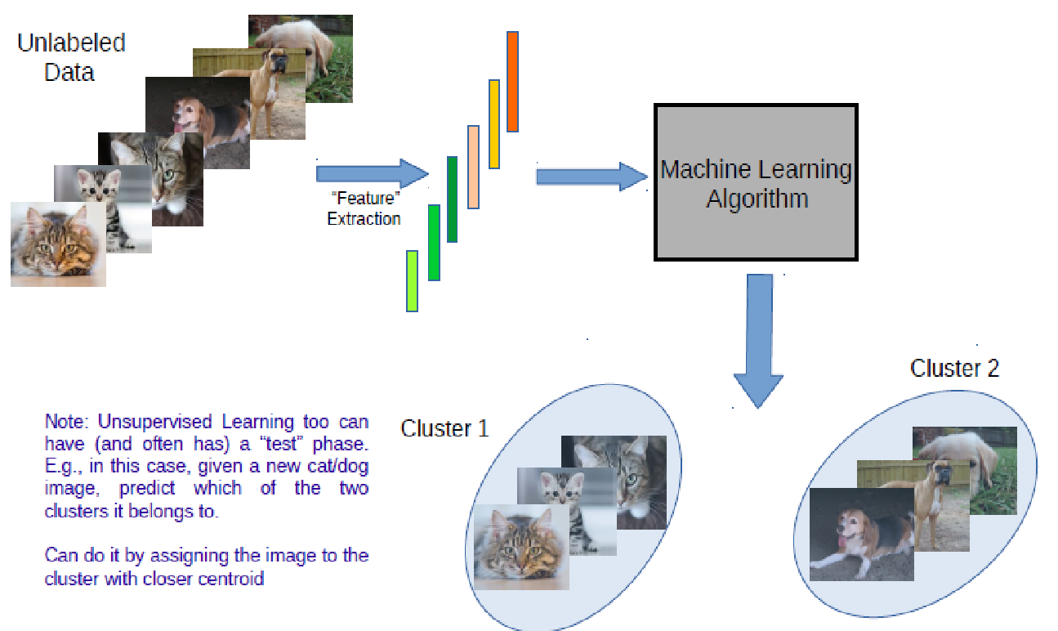
A Typical Unsupervised Learning Workflow (for Clustering)
Slide Credit: Piyush Rai

Slide 43
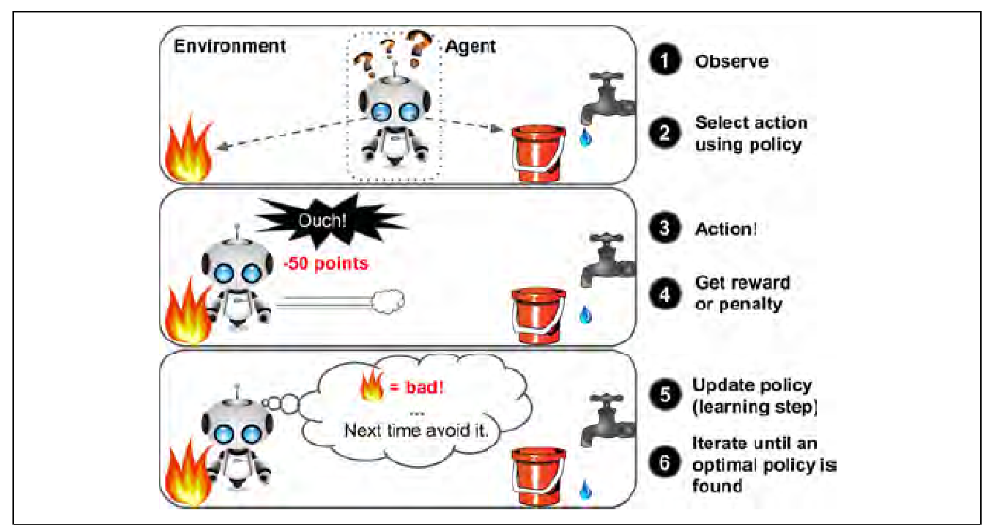
Reinforcement Learning

Slide 44
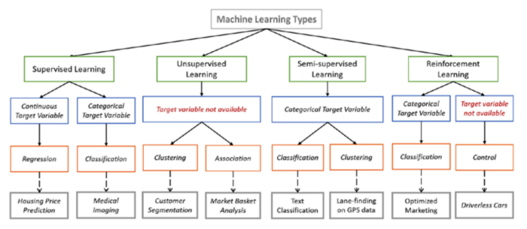
Summary : Types of Learning
Image courtesy: https://towardsdatascience.com/types-of-machine-learning-algorithms-you-should-know-953a08248861

Slide 45
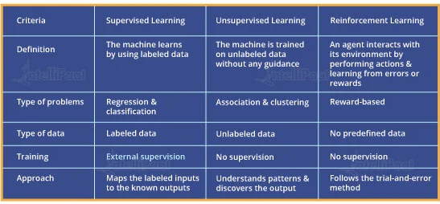
Comparison : Supervised, Unsupervised and Reinforcement Learning

Slide 46
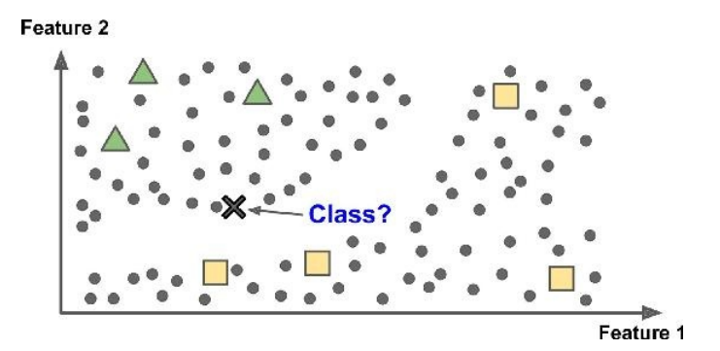
Introduction to Machine Learning
Semi supervised Learning
Partially labelled data – some labelled data and a lot of unlabelled data
Combines unsupervised and supervised learning algorithms
Photo hosting service, e.g., google photos

Slide 47
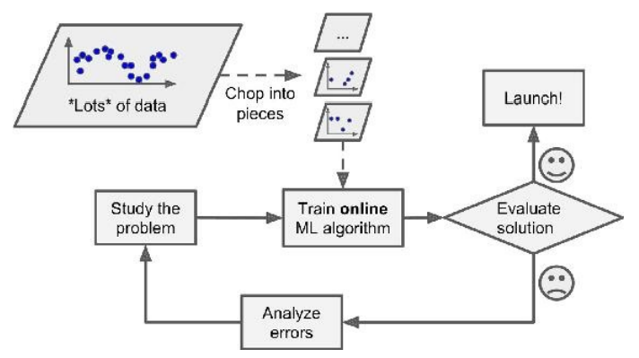
Introduction to Machine Learning
Types: Based on how training data is used
Batch learning: Uses all available data at a time during training
Mini Batch learning: Uses a subset of available at a time during training
Online (incremental) learning: Uses single training data instance at a time during training

Slide 48
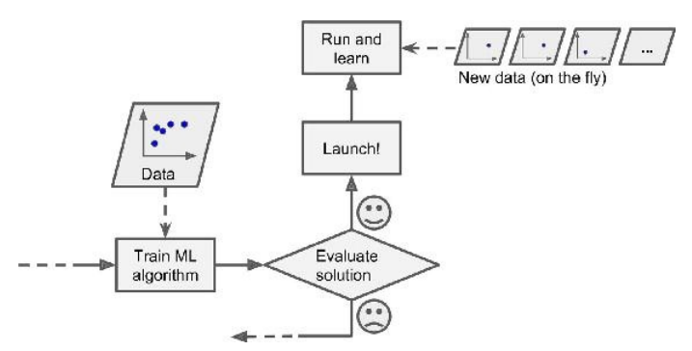
Introduction to Machine Learning
Types: Based on how training data is used
Batch learning: Uses all available data at a time during training
Mini Batch learning: Uses a subset of available at a time during training
Online (incremental) learning: Uses single training data instance at a time during training

Slide 49
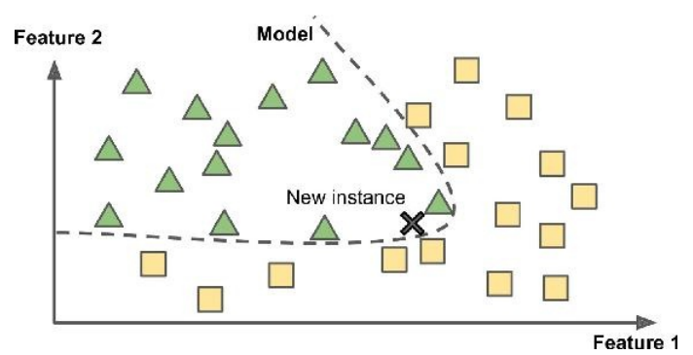
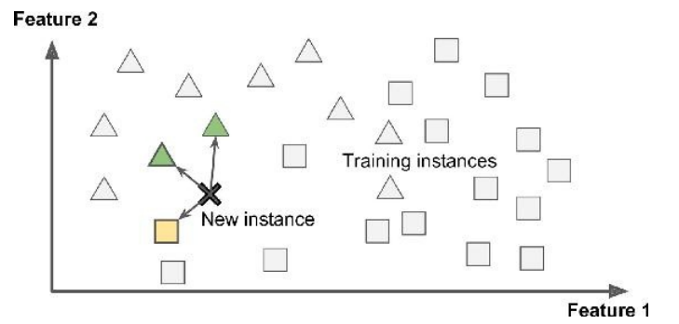
Introduction to Machine Learning
Types: Based on how training data is used
Instance Based Learning: Compare new data points to known data points
Model Based learning : Detect patterns in the training data and build a predictive model
Instance Based
Model Based

Slide 50
Open source ML programming tools
 | Platform |  | Algorithms or Features
Scikit Learn | Linux, Mac OS, Windows | Python, C, C++ | Classification, Regression, Clustering Preprocessing, Model Selection Dimensionality reduction.
PyTorch | Linux, Mac OS, Windows | Python, C++ | Autograd Module, Optimization Module NN Module
TensorFlow | Linux, Mac OS, Windows | Python, C++ | Provides a library for dataflow programming.
Weka | Linux, Mac OS, Windows | Java | Data preparation, Classification Regression, Clustering, Visualization Association rules mining

Slide 51
Open source ML programming tools
Colab | Cloud Service | - | Supports libraries of PyTorch, Keras, TensorFlow, and OpenCV
Apache Mahout | Cross-platform | Java Scala | Preprocessors,Regression Clustering, Recommenders Distributed Linear Algebra.
Accors.Net | Cross-platform | C# | Classification, Regression, Distribution Clustering, Hypothesis Tests & Kernel Methods, Image, Audio & Signal & Vision
Shogun | Windows Linux, UNIX Mac OS | C++ | Regression, Classification, Clustering Support vector machines. Dimensionality reduction, Online learning etc.
Keras.io | Cross-platform | Python | API for neural networks

Slide 52
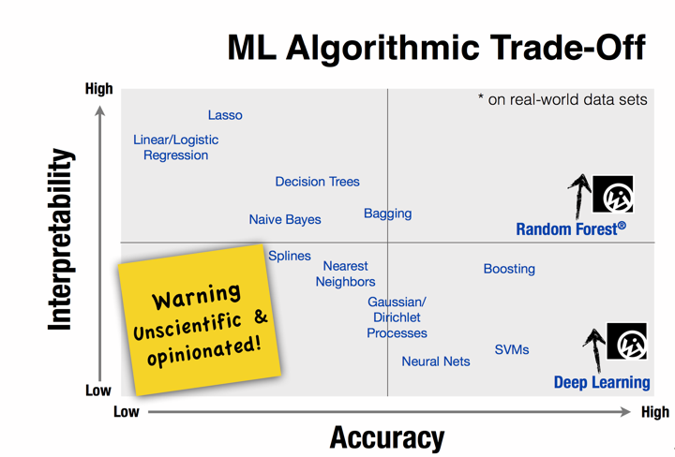

Slide 53
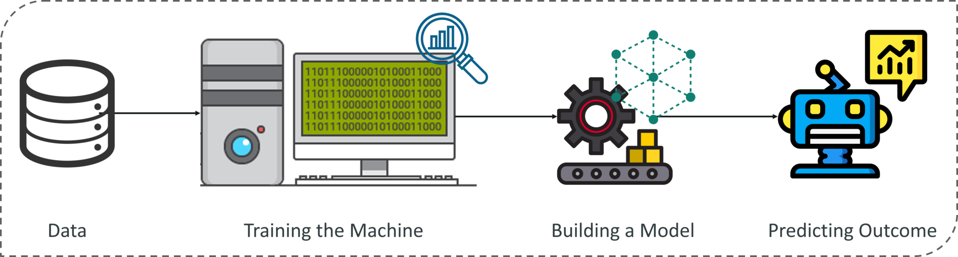
ML workflow

Slide 54
ML workflow
Should I use ML on this problem?
Is there a pattern to detect?
Can I solve it analytically?
Do I have data?
Gather and organize data.
Preprocessing, cleaning, visualizing.
Choosing a model, loss, regularization, ...
Optimization
Hyper parameter search.
Analyze performance and mistakes, and iterate back to step 5 (or 3)

Slide 55


Demo Case Study
: Car Price prediction based on Mileage
Define the Objective
Data Gathering: survey, Past Purchase data
Data Preprocessing
training set; test set
representation of input features; output
Exploratory Data Analysis
Choose form of model: linear regression
System’s performance evaluation: objective function
Optimize performance by setting appropriate parameters: Optimization
Evaluate on test set: generalization

Slide 56

References
Chapter 1 – Machine Learning, Tom Mitchell
Chapter 1, 2 – Introduction to Machine Learning, 2nd edition, Ethem Alpaydin
Chapter 1 - Pattern Recognition & Machine Learning Christopher M. Bhishop
http://www.cs.princeton.edu/courses/archive/spr08/cos511/ [Web]
https://www.softwaretestinghelp.com/machine-learning-tools/
BITS Pilani, Deemed to be University under Section 3 of UGC Act, 1956

Slide 57
Thank you !

